Slide 1
End-to-End Machine Learning with ML.NET and Azure CodeCampNYC 2018 Luis Quintanilla

Slide 2

Marquee Sponsor

Slide 3








Platinum Sponsors
Gold Sponsors
Silver Sponsors

Slide 4





Hello ☺
Artificial Intelligence Consultant
lqdev@outlook.com
http://luisquintanilla.me
@ljquintanilla
https://github.com/lqdev
Notes:
Consultant
Interests: Artificial Intelligence, IoT and all things .NET
GitHub: lqdev
Twitter: @ljquintanilla
Blog: luisquintanilla.me

Slide 5
Code & Slides
http://bit.ly/codecampnyc2018

Slide 6
Agenda
01
What is Machine Learning?
02
From Data to Machine Learning
03
Building a Model
04
Deploying a Model
Notes:
What is Machine Learning
From Data to Machine Learning
Building a Model
Deploying a Model

Slide 7
What is Machine Learning?

Slide 8
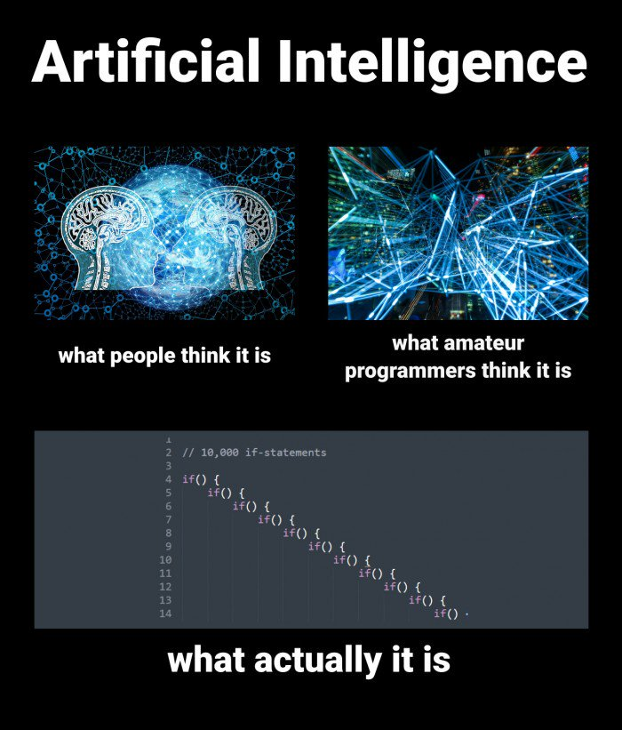

Slide 9
AI vs ML
Artificial Intelligence
Machine Learning
Notes:
AI
Automating tasks usually performed by humans
Rules-Based Systems/Symbolic Programming
Example: If-Then
Machine Learning
Finding useful data representations within a predefined space
Example: Linear Regression

Slide 10
Machine Learning Tasks
Supervised Learning
Unsupervised Learning
Regression
Classification
Clustering
What is the price of a home in NYC?
Is this a dog or cat?
Customer segments in a database
Notes:
Supervised Learning
Regression – What is the price of a home in NYC?
Classification – Is this a dog or a cat?
Unsupervised Learning
Clustering – What kinds of topics are present in this database

Slide 11
Classification Example
Training Data
New Data
Species | Is Independent | Class
Canine | False | Dog
Feline | True | Cat
Feline | True | Cat
Canine | False | Dog
Canine | True | Dog
Species | Is Independent
Canine | False
Prediction
Features
(input)
Label
(output)
Class
Dog

Slide 12
From Data to Machine Learning

Slide 13

The Continuous Machine Learning Process

Slide 14

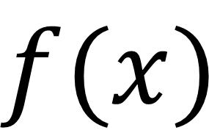
What is a model?
True
$$f(x)$$
False
Input
Model
Output

Slide 15
Building a Machine Learning Model

Slide 16
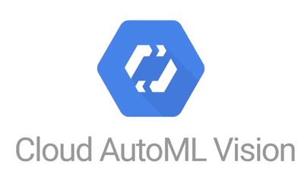













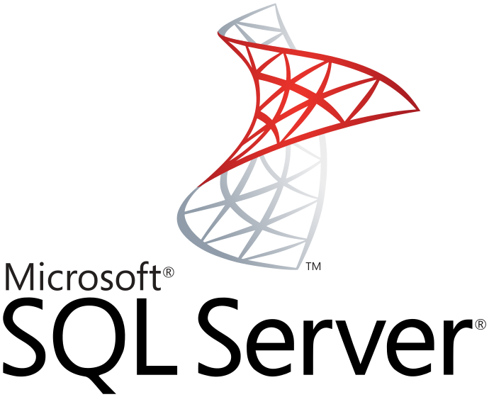

Machine Learning Tools

Slide 17



Automated vs. Custom
Automated
Custom

Slide 18


Slide 19

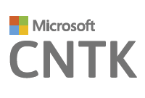
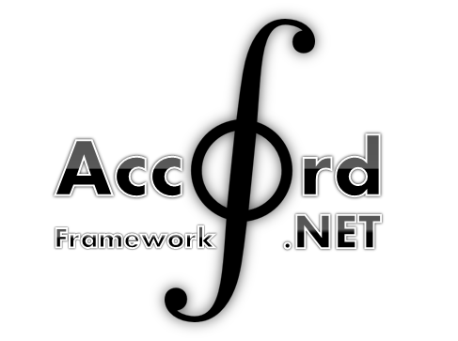

.NET Tools

Slide 20




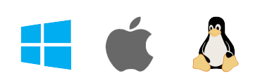
ML.NET
Framework for Machine Learning
Proven & Extensible
.NET Standard
Open Source
Cross Platform
Notes:
Framework for custom Machine Learning
.NET Standard
Proven & Extensible
Open Source
Cross Platform

Slide 21
ML.NET - Framework
Transformations
Missing Values
Feature Selection
Learners
SVM
K-Means
Misc
Data Loaders
Evaluators
Extensions
Normalization
Boosted Trees
TensorFlow
CNTK
ONNX
Accord.NET
Notes:
Build and train ML.NET Models
Run ANY Model

Slide 22
A few things you can do with ML.NET …
Sentiment Analysis
Forecasting
Issue Classification
Predictive maintenance
Image classification
Recommendations
Object detection
Customer segmentation
And more! Samples @ https://github.com/dotnet/machinelearning-samples

Slide 23
Iris Classification Model
Class Library
Azure
Model
Azure Container Instances Application
Azure Functions Application
Console Application

Slide 24
Demo: Training a Model

Slide 25
Consuming a Machine Learning Model

Slide 26




Model Consumption Methods
Desktop
Mobile
Web
IoT
Notes:
Desktop
Mobile
Web
IoT
Wherever .NET Runs*

Slide 27



Deploying to the Web
Virtual Machines
Containers
Serverless
Notes:
https://dzone.com/articles/virtual-machines-vs-containers-vs-serverless-compu

Slide 28
Demo: Deploying a Model to Azure Container Instances

Slide 29
Demo: Deploying a Model to Azure Functions

Slide 30
Takeaways
ML.NET is a proven, open-source, cross-platform machine learning framework for building custom models in the .NET ecosystem.
ML.NET is still in its early stages but is quickly maturing with strong support from open source community and Microsoft.
Model persistence provides great flexibility in model deployment phase.
Azure (Container Instances and Functions) reduces friction and management overhead associated with deployment of ML.NET models to the web.

Slide 31
Questions?

Slide 32
Resources
https://docs.microsoft.com/en-us/azure/container-instances/
https://docs.microsoft.com/en-us/azure/azure-functions/functions-run-local
https://blogs.msdn.microsoft.com/dotnet/2018/10/08/announcing-ml-net-0-6-machine-learning-net/
https://docs.microsoft.com/en-us/dotnet/machine-learning/resources/glossary
https://docs.microsoft.com/en-us/dotnet/machine-learning/tutorials/
http://luisquintanilla.me/2018/08/21/serverless-machine-learning-mlnet-azure-functions/
http://luisquintanilla.me/2018/05/11/deploy-netml-docker-aci/

